Slide 1
FAEN 301: Numerical Methods
Lecture 1: Introduction to Numerical Methods
Dr. Nii Longdon Sowah
April 2021

Slide 2
Numerical Methods and Analysis
Engineers encounter real world problems everyday. Our role is to solve them as efficiently and accurately as possible.
Unfortunately, real world problems do not usually come in single variable or second-degree equations!
Numerical analysis is the study of algorithms that use numerical approximation (as opposed to general symbolic manipulations) for problems that need mathematical analysis.
Approximations come with errors that must be factored into the mathematical analysis.

Slide 3
Numerical methods and analysis
Basic Needs in the Numerical Methods:
Practical:
Can be computed in a reasonable amount of time.
Accurate:
Good approximate to the true value,
Information about the approximation error (Bounds, error order,… ).

Slide 4
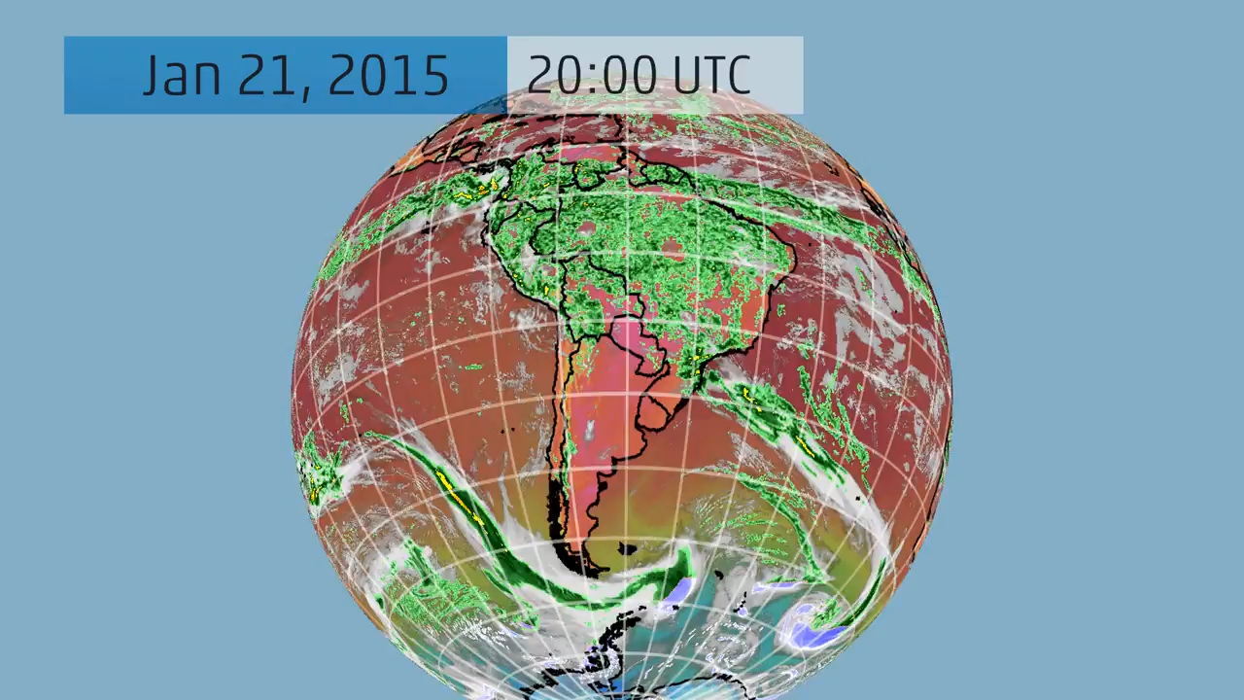
Applications of Numerical Analysis
Making weather predictions based on many natural factors (wind velocity, solar radiation, humidity, etc)
Gene simulations
Crash safety simulations of cars.
Private investment funds use numerical analysis to predict values of stock.
Several forms of modelling and simulation involve numerical analysis.

Slide 5
Non-Linear Equations
Some simple equations can be solved analytically:
Even some slightly complex ones cannot be solved analytically!

Slide 6
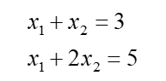
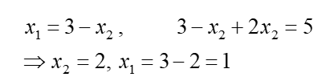
System of Linear Equations
Consider the system below:
Using Substitution, we solve as:
What if there are 70 equations with 70 unknowns?

Slide 7
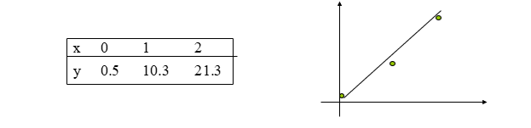
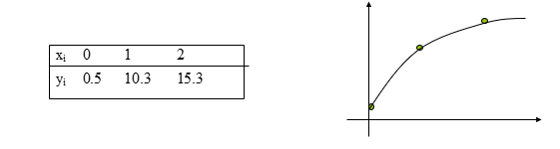
Curve Fitting
Given a set of data:
Which polynomial P(x) passes through all the points?

Slide 8
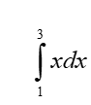
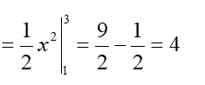
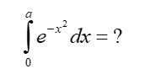
Integrations
Some functions can be integrated analytically.
But Several functions cannot be solved analytically.

Slide 9
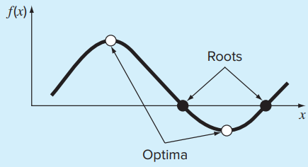
Common numerical methods
Roots and optimization
Roots: Solve for x so that f(x) = 0 Optimization:
Solve for x so that f'(x) = 0

Slide 10
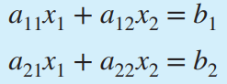
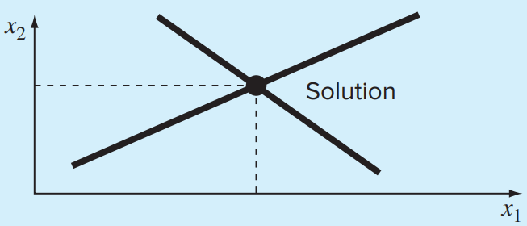
Common numerical methods
Linear algebraic equations
Given the a’s and the b’s, solve for the x’s

Slide 11
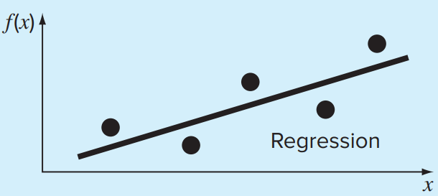
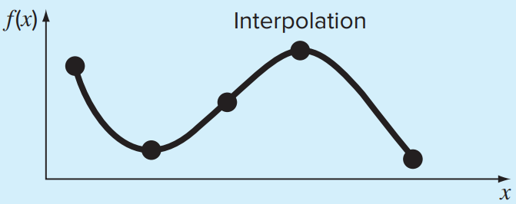
Common numerical methods
Curve fitting

Slide 12
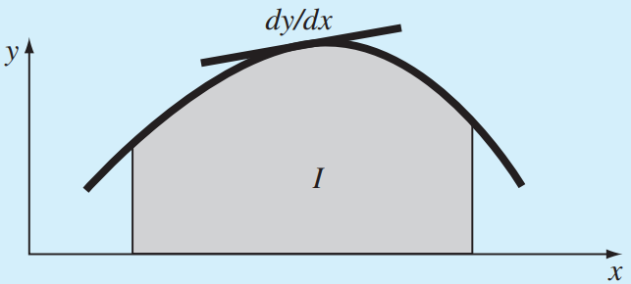
Common numerical methods
Integration and differentiation
Integration: Find the area under the curve
Differentiation: Find the slope of the curve

Slide 13
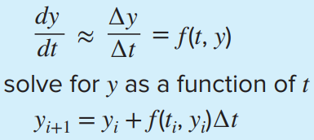
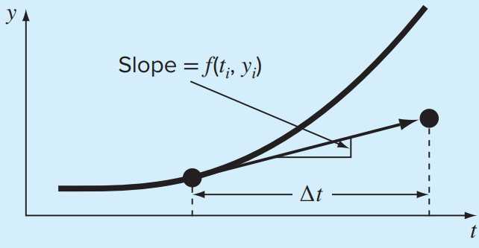
Common numerical methods
Differential equations
Given

Slide 14
Common numerical methods

Slide 15
Common numerical methods

Slide 16
Rounding and TRUNCATION
The computer’s way of representing numbers like 1.1
Rounding : Replacing the number with the nearest machine number.
Truncation : Throwing away all extra digits

Slide 17
Accuracy and precision
Accuracy refers to how closely a computed or measured value agrees with the true value.
Precision refers to how closely individual computed or measured values agree with each other.
Inaccuracy (also called bias) is defined as systematic deviation from the truth.
Imprecision (also called uncertainty) refers to the magnitude of the scatter.
Numerical methods should be sufficiently accurate and precise.
The term error is used to describe the inaccuracy and imprecision of solutions.

Slide 18
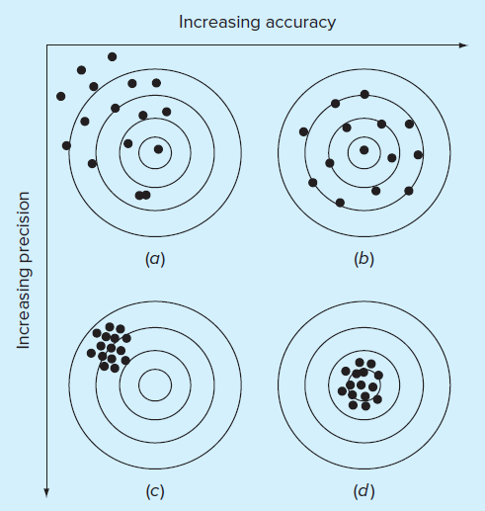
Accuracy and precision
Inaccurate and imprecise
Accurate and imprecise
Inaccurate and precise
Accurate and precise

Slide 19
The Issue of Errors
Error is the value of inaccuracy on a measure/quantity.
It is important to account for errors in numerical computations.
Since solutions are approximations and not exact values
In iterative methods, errors accumulate into a large value
Errors must be as small as possible implying high accuracy
The point of numerical analysis is to analyze methods that are used to give approximate number solutions to situations where it is unlikely to find the real solution quickly.
We improve upon these methods to reduce the error generated by computer calculation.

Slide 20
Calculating Errors
True Error: Calculated if the true outcome of a computation is known.
Estimated Error: Calculated if the true outcome of a computation is not known.
Absolute Error: Error given with the same units as the measure itself.
Relative Error: Error expressed in relation to the measured value.
 | True Error | Estimated Error
Absolute | Absolute true error | Absolute estimated error
Relative | Relative true error | Relative estimated error

Slide 21
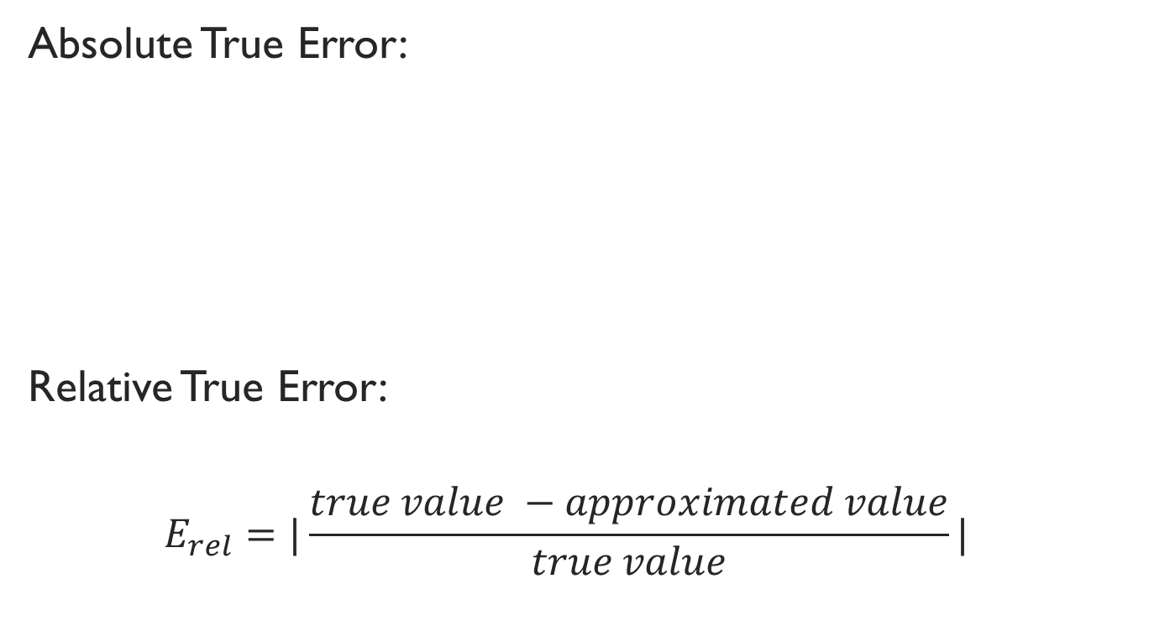
Calculating Errors
Absolute True Error:
Relative True Error:
$$E_{rel}=|\frac{true value −approximated value}{true value}|$$
$$E_{t}=| true value −approximated value |$$

Slide 22
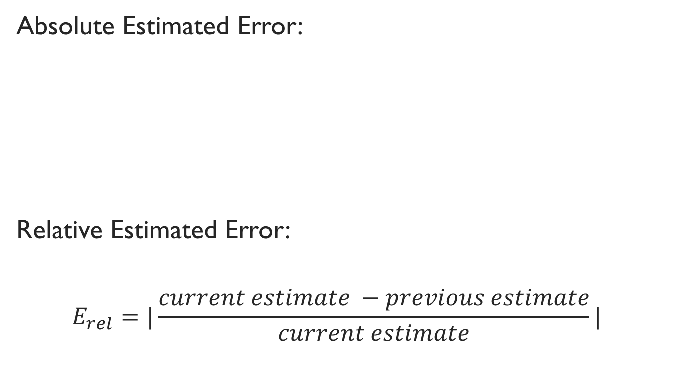
Calculating Errors
Absolute Estimated Error:
Relative Estimated Error:
$$E_{rel}=|\frac{current estimate −previous estimate}{current estimate}|$$
$$E_{t}=| current estimate −previous estimate|$$

Slide 23
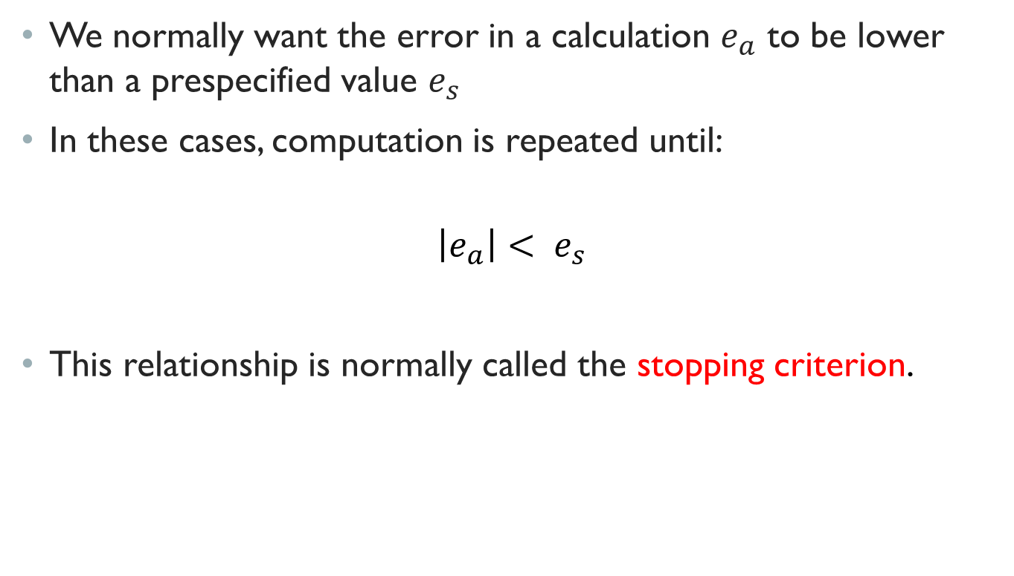
Calculating Errors
We normally want the error in a calculation $e_{a}$ to be lower than a prespecified value $e_{s}$
In these cases, computation is repeated until:
$$\left|e_{a}\right|< e_{s}$$
This relationship is normally called the stopping criterion.

Slide 24
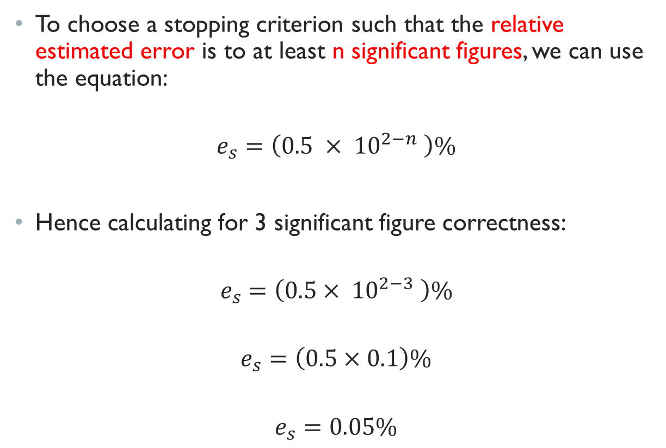
Choosing a stopping criterion
To choose a stopping criterion such that the relative estimated error is to at least n significant figures, we can use the equation:
$$e_{s}=\left(0.5 × {10}^{2−n} \right)\%$$
Hence calculating for 3 significant figure correctness:
$$e_{s}=\left(0.5× {10}^{2−3} \right)\%$$
$$e_{s}=\left(0.5×0.1\right)\%$$
$$e_{s}=0.05\%$$

Slide 25
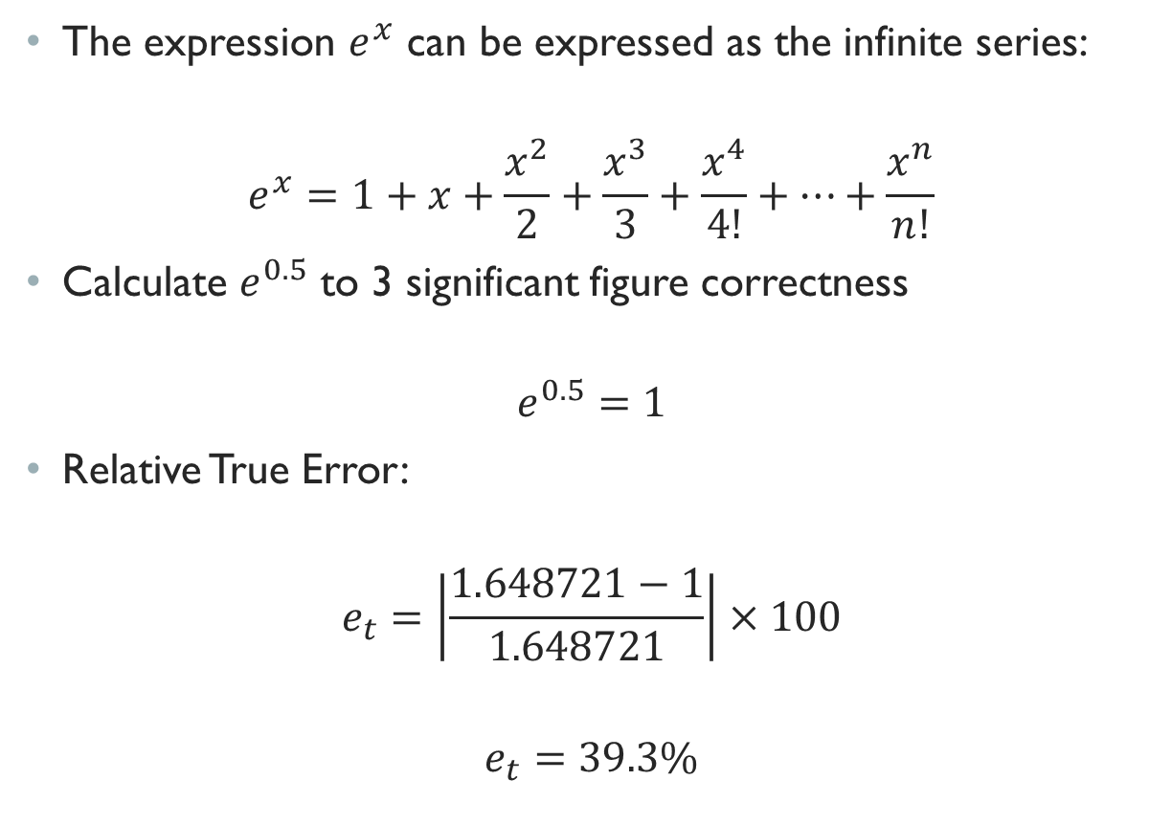
Example: Calculating $e^{0.5}$
The expression $e^{x}$ can be expressed as the infinite series:
$$e^{x}=1+x+\frac{x^{2}}{2}+\frac{x^{3}}{3}+\frac{x^{4}}{4!}+…+\frac{x^{n}}{n!}$$
Calculate $e^{0.5}$ to 3 significant figure correctness
$$e^{0.5}=1$$
Relative True Error:
$$e_{t}=\left|\frac{1.648721−1}{1.648721}\right|×100$$
$$e_{t}=39.3\%$$
STEP 1:

Slide 26
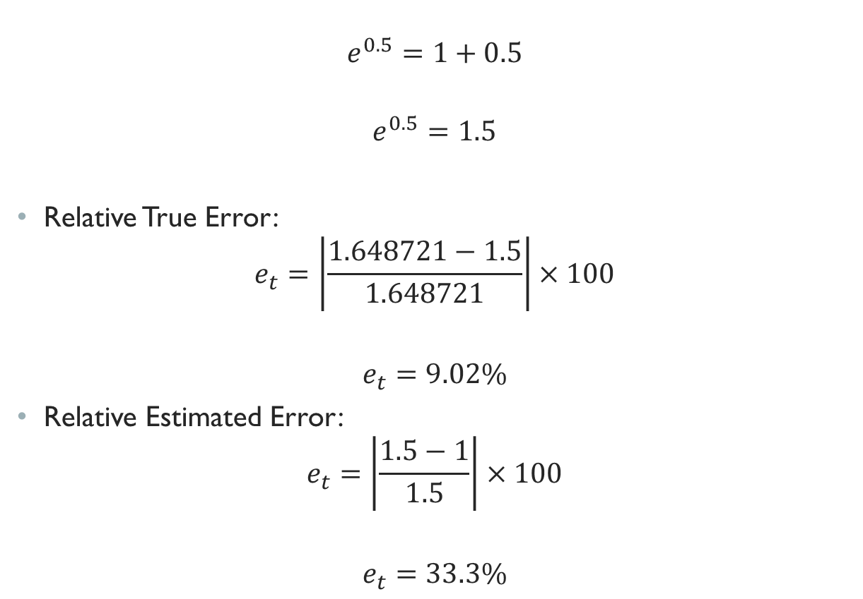
Example: Calculating $e^{0.5}$
$$e^{0.5}=1+0.5$$
$$e^{0.5}=1.5$$
Relative True Error:
$$e_{t}=\left|\frac{1.648721−1.5}{1.648721}\right|×100$$
$$e_{t}=9.02\%$$
Relative Estimated Error:
$$e_{t}=\left|\frac{1.5−1}{1.5}\right|×100$$
$$e_{t}=33.3\%$$
STEP 2:

Slide 27
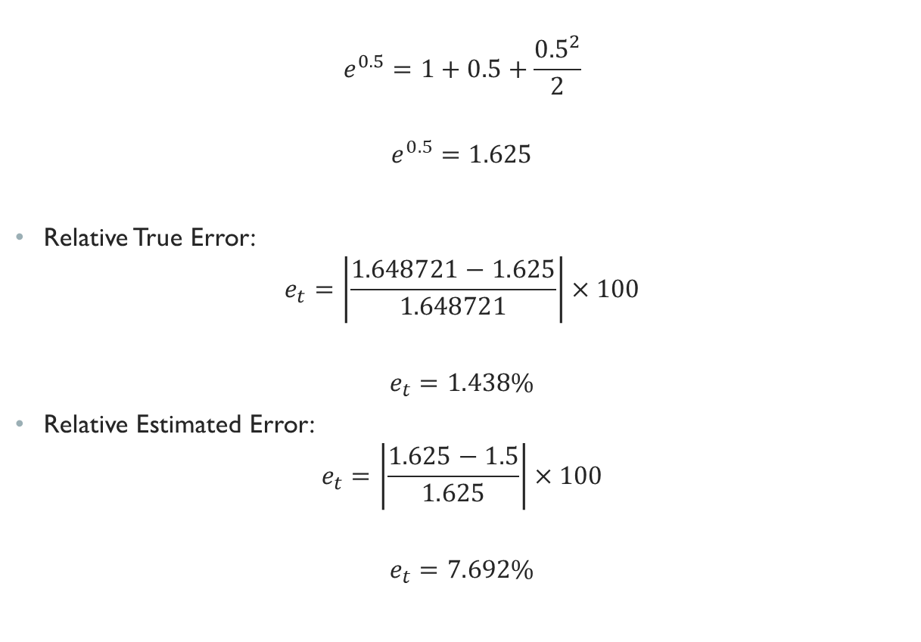
Example: Calculating $e^{0.5}$
$$e^{0.5}=1+0.5+\frac{{0.5}^{2}}{2}$$
$$e^{0.5}=1.625$$
Relative True Error:
$$e_{t}=\left|\frac{1.648721−1.625}{1.648721}\right|×100$$
$$e_{t}=1.438\%$$
Relative Estimated Error:
$$e_{t}=\left|\frac{1.625−1.5}{1.625}\right|×100$$
$$e_{t}=7.692\%$$
STEP 3:

Slide 28
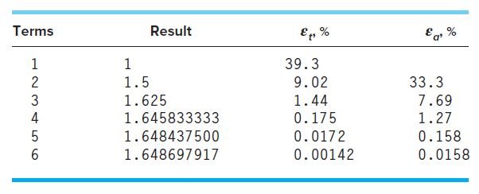
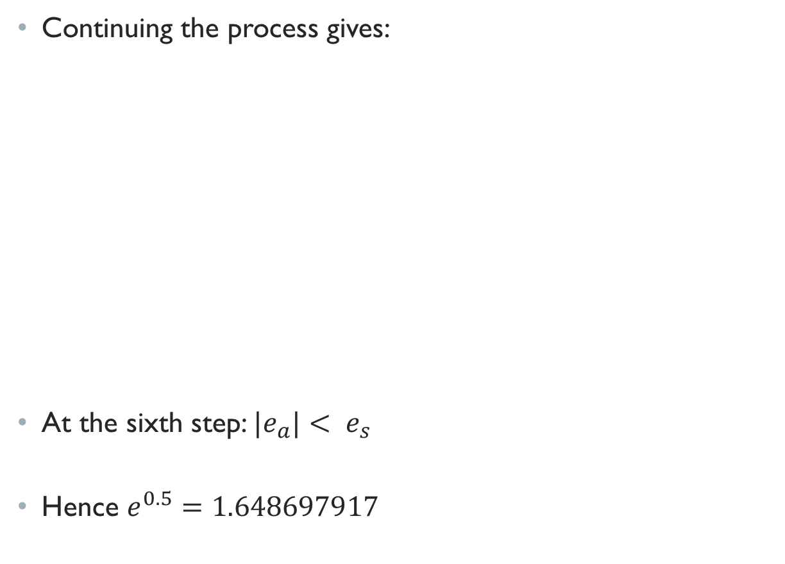
Example: Calculating $e^{0.5}$
Continuing the process gives:
At the sixth step: ${|e}_{a}|< e_{s}$
Hence $e^{0.5}=1.648697917$

